Slide 1
Medlytics Week 1 Challenge Project
Predicting Hypothyroidism
July 6 ‒ 10 2020
Notes:
1
1
Check distro statement before using:
DISTRIBUTION STATEMENT A. Approved for pubic release: distribution is unlimited.
This material is based upon work supported under Air Force Contract No. FA8721-05-C-0002 and/or FA8702-15-D-0001. Any opinions, findings, conclusions or recommendations expressed in this material are those of the author(s) and do not necessarily reflect the views of the U.S. Air Force.
© 2020 Massachusetts Institute of Technology.
Delivered to the U.S. Government with Unlimited Rights, as defined in DFARS Part 252.227-7013 or 7014 (Feb 2014). Notwithstanding any copyright notice, U.S. Government rights in this work are defined by DFARS 252.227-7013 or DFARS 252.227-7014 as detailed above. Use of this work other than as specifically authorized by the U.S. Government may violate any copyrights that exist in this work.

Slide 2
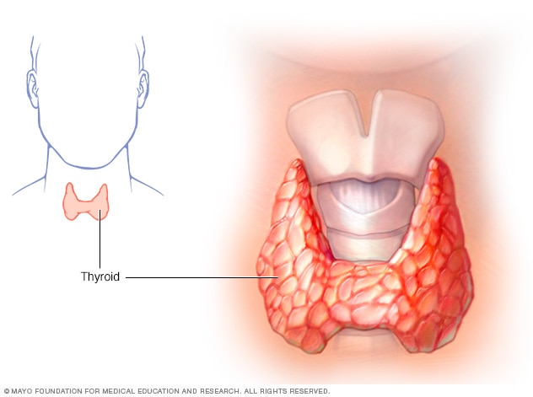
Challenge Overview
Hypothyroidism describes an endocrine disorder in which the thyroid gland underproduces thyroid hormones. There are many ways in which a thyroid gland may become damaged, including something as simple as a lack of iodine in the diet.
The disorder is associated with a variety of non-specific symptoms, making it difficult to diagnose without a blood test. For this reason, a model that can assist doctors in predicting whether a patient suffers from hypothyroidism would be extremely valuable.
In this challenge, teams will examine a training data set containing detailed information on a sample of patients. Each team will use machine learning to build multiple predictive models. Then, using a test data set, we will evaluate the performance of these models.
The goal is not to produce a perfect model, but to identify which patient features from our data are most useful for predicting hypothyroidism.
Notes:
1
1
Check distro statement before using:
DISTRIBUTION STATEMENT A. Approved for pubic release: distribution is unlimited.
This material is based upon work supported under Air Force Contract No. FA8721-05-C-0002 and/or FA8702-15-D-0001. Any opinions, findings, conclusions or recommendations expressed in this material are those of the author(s) and do not necessarily reflect the views of the U.S. Air Force.
© 2020 Massachusetts Institute of Technology.
Delivered to the U.S. Government with Unlimited Rights, as defined in DFARS Part 252.227-7013 or 7014 (Feb 2014). Notwithstanding any copyright notice, U.S. Government rights in this work are defined by DFARS 252.227-7013 or DFARS 252.227-7014 as detailed above. Use of this work other than as specifically authorized by the U.S. Government may violate any copyrights that exist in this work.

Slide 3
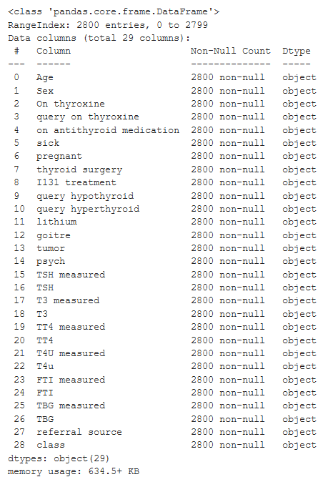
Data Set
For the purposes of this challenge, we will divide a single data set into test and training subsets. The data originates from the Garavan Institute, a real-world research organization located near Sydney, Australia.
The full data set contains 2800 entries with 29 features. Some data is missing from the data set, represented in the source file with question marks (“?”).
The entries have already been classified for hypothyroidism. However, there are four possible classifications: “negative,” “compensated hypothyroid,” “primary hypothyroid,” and “secondary hypothyroid.” For our purposes, any non-negative classification will be considered positive.
We will set aside 20% of the data as a test set (the same set for each team). Teams are free to build models using any techniques they have learned. Since the goal is to identify which features have the most predictive power, teams should build multiple models with different subsets of the data.
Notes:
1
1
Check distro statement before using:
DISTRIBUTION STATEMENT A. Approved for pubic release: distribution is unlimited.
This material is based upon work supported under Air Force Contract No. FA8721-05-C-0002 and/or FA8702-15-D-0001. Any opinions, findings, conclusions or recommendations expressed in this material are those of the author(s) and do not necessarily reflect the views of the U.S. Air Force.
© 2020 Massachusetts Institute of Technology.
Delivered to the U.S. Government with Unlimited Rights, as defined in DFARS Part 252.227-7013 or 7014 (Feb 2014). Notwithstanding any copyright notice, U.S. Government rights in this work are defined by DFARS 252.227-7013 or DFARS 252.227-7014 as detailed above. Use of this work other than as specifically authorized by the U.S. Government may violate any copyrights that exist in this work.

Slide 4
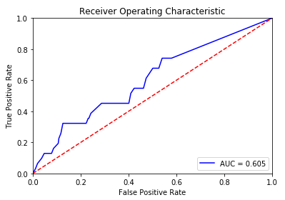
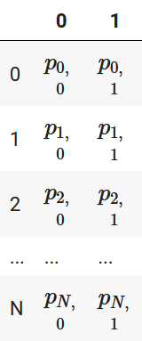
Project Evaluation
Communication is extremely important for analysts. For this challenge, teams will be expected to share their findings to the class. The presentation should describe the team’s approach and highlight which features the team found to be the most predictive.
For this presentation, try to make use of descriptive plots. You
are encouraged to make use of any Matplotlib or seaborn techniques you have learned.
The presentations will be evaluated on two bases:
Quality of the presentation. You must be able to clearly describe your modeling approach and evaluate your results. You need to convince us that your model is a good choice.
Accuracy of the model. Teams will be evaluated on their model’s ability to predict hypothyroidism in the test set. For sake of comparison, we will use the “area under curve” metric for accuracy.
Notes:
1
1
Check distro statement before using:
DISTRIBUTION STATEMENT A. Approved for pubic release: distribution is unlimited.
This material is based upon work supported under Air Force Contract No. FA8721-05-C-0002 and/or FA8702-15-D-0001. Any opinions, findings, conclusions or recommendations expressed in this material are those of the author(s) and do not necessarily reflect the views of the U.S. Air Force.
© 2020 Massachusetts Institute of Technology.
Delivered to the U.S. Government with Unlimited Rights, as defined in DFARS Part 252.227-7013 or 7014 (Feb 2014). Notwithstanding any copyright notice, U.S. Government rights in this work are defined by DFARS 252.227-7013 or DFARS 252.227-7014 as detailed above. Use of this work other than as specifically authorized by the U.S. Government may violate any copyrights that exist in this work.

